Slide 1
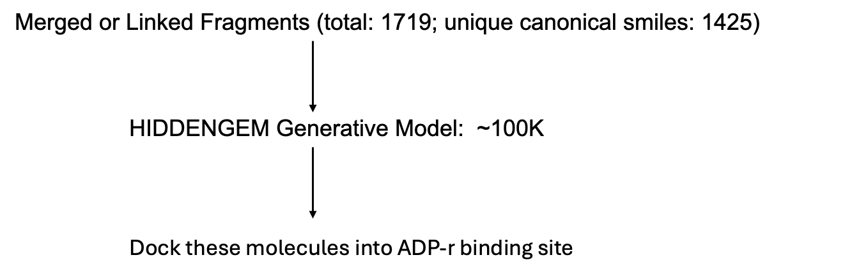
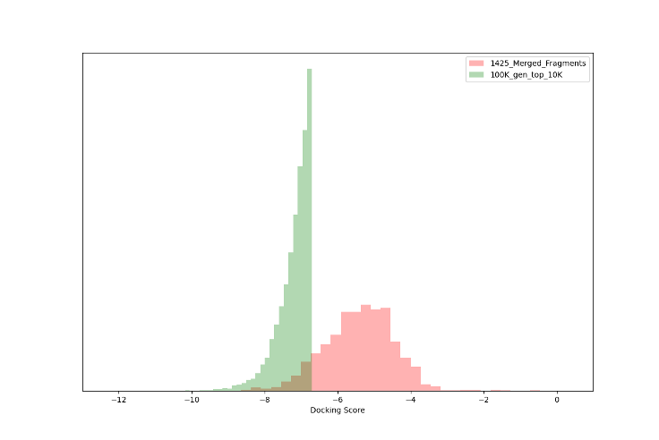
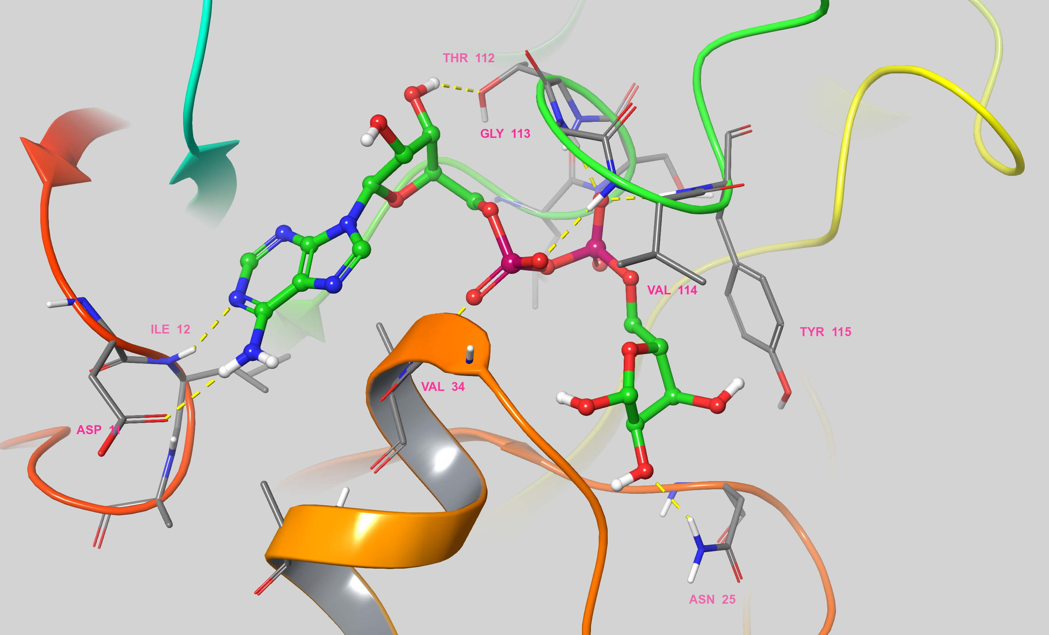
CHICKV NSP3 MD Fragments
Haoxi Li
Collaborating with Josh (MML), Hadia, Rahman (UCL), Jasmin and Daren (Diamond)
Docking Score Distribution
PDB: 6VUQ

Slide 2
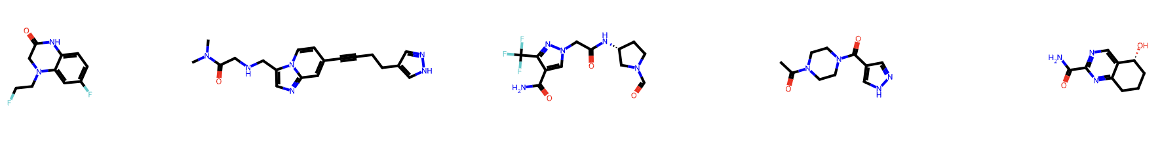
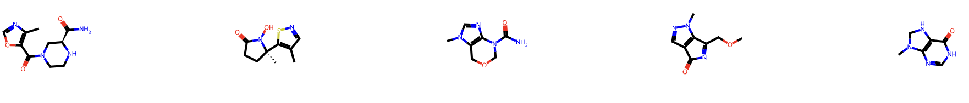
CHICKV NSP3 MD Fragments
Haoxi Li
Collaborating with Josh (MML), Hadia, Rahman (UCL), Jasmin and Daren (Diamond)
Next: search similar molecules from Enamine Library
Group the top 10K compounds into 409 clusters, pick one molecule each cluster
Filtered with StopLight, resulting in 89 molecules

